Slide 1
Cortana Intelligence Suite
Transform data into intelligent action

Slide 2
Azure PPE Technical Training
Module 1 – Introducing Cortana Intelligence Suite | Day 1
Module 2 – Information Management
Module 3 – Big Data Stores | Day 2
Module 4 – Machine Learning and Analytics Part 1
Module 5 – Machine Learning and Analytics Part 2 | Day 3
Module 6 – Cognitive Services
Module 7 – Power BI and Power BI Embedded | Day 4
Audience: Architects, Data Scientists and Developers

Slide 3
Three major trends are converging
Big Data & IoT
Cloud
Intelligence

Slide 4
We now face a world of connected data
CONNECTED
CLOUD/IOT
DIGITAL
ANALOG
MOBILE
1985
1990
1995
2000
2005
2010
2015
2020

Slide 5

Data is a key strategic asset
$1.6T
10%
Additional business value captured by companies that are leaders in using data assets to their advantage
Source: IDC, 2014
Percent of organizations expected to have a highly profitable business unit specifically for productizing and commercializing their data by 2020
Source: Gartner, 2016

Slide 6
Here is how successful companies are staying ahead
Improving visibility and making accurate predictions with remote monitoring
Getting the right products to the right places with inventory management
Offering customers exactly what they want, when they want it, with personalization
Fixing problems proactively before they start with predictive maintenance
Exploring new business opportunities with data-driven services

Slide 7

From data to decisions and actions
What happened?
Why did it happen?
What will happen?
What should I do?
Insight
Interactive
Dashboards
Predictive
Models
Recommendations
& Automation
Reports

Slide 8
Opportunities exist across functional areas
EXAMPLE SOLUTIONS
Sales and marketing
Finance and risk
Customer and channel
Operations and workforce
Customer Acquisition
Fraud detection
Lifetime customer value
Pay for performance
Cross-sell and upsell
Credit risk management
Personalized offers
Operational efficiency
Loyalty programs
Product recommendation
Smart buildings
Marketing mix optimization
Predictive maintenance
Supply chain management

Slide 9
Cortana Intelligence Key Verticals
Retail
Healthcare
Financial Services
Industry Overview
$22 trillion global revenue ($4.7 trillion U.S.)
4% annual growth rate
3.7 million businesses
42 million employees
Industry Trends
Commerce anywhere, anytime
Personal and in context
Scenarios
Sales & Marketing: Demand Forecasting
Customer & Channel: Personalized Offers
Industry Overview
$2 trillion spent in U.S./year on healthcare
5,754 hospitals with >36 million patients
Hospital readmissions cost ~$41 billion/year
ACA new regulations for Medicare/Medicaid
Industry Trends
Payments based on patient outcome
Government monitoring hospital readmissions and number of hospital-acquired conditions
Scenarios
Customer & Channel: Patient Outcomes
Operations & Workforce: Operational Efficiency
Industry Overview
7.9% of US Economy
$1.2 trillion revenue
12% revenue growth rate
5.9 million employees
Industry Trends
Understanding customer behavior
Cybersecurity
Taking banking “mobile”
Proactive regulatory compliance
Scenarios
Finance & Risk: Risk & Compliance
Sales & Marketing: Personalization

Slide 10
Introducing Cortana Intelligence

Slide 11
Cortana Intelligence Suite Transform data into intelligent action
Data Sources
People
Apps
Apps
Sensors & Devices
Automated systems
Cortana Intelligence
Data
Intelligence
Action

Slide 12
It combines relevant data from anywhere
Reduce costs by collecting, storing, and processing data in the cloud
Scale infinitely and manage planned or unexpected events with elastic data stores
Aggregate any type of data and connect information to wherever you need it

Slide 13
And leverages advanced analytics
Detect subtle patterns and insights by analyzing massive amounts of data from many sources
Shape new business outcomes by predicting what may happen in the future
Automate decision-making to accelerate business and aid competitive advantage

Slide 14
Along with innovative intelligence capabilities
Learn more about your customers using speech, text, face and emotion analysis
Personalize customer interactions with intelligent agents that converse in contextual, natural ways
Build models that understand natural language and recognize what users want

Slide 15
Transform data into intelligent action with Cortana Intelligence
Easy & Actionable
Analytics
Secure & Scalable
Big Data
Cognitive & Contextual
Intelligence

Slide 16
Cortana Intelligence Suite Transform data into intelligent action
Information Management
Big Data Stores
Machine Learning and Analytics
Intelligence
Data Sources
People
Data Factory
Data Lake Store
Machine Learning
Cognitive Services
Data Catalog
SQL Data
Warehouse
Data Lake Analytics
Bot Framework
Web
Apps
Event Hubs
HDInsight
Cortana
Mobile
Apps
Stream Analytics
Bots
Dashboards & Visualizations
Sensors and devices
Power BI
Automated Systems
Data
Intelligence
Action

Slide 17
Demo: Vehicle health and driving behavior patterns

Slide 18
Turning telemetry data from vehicles into insight
75%
of the cars shipped globally by 2020 will be built with the necessary hardware to connect to the Internet
So what can we do with that data?
Vehicle diagnostic
What parts need maintenance first on all Ford F-150’s sold?
Roadside
assistance
Fleet management
Show me the location of all vehicles within 50mi of my location
Engine emission control
What is the emissions status of vehicle B204?
Eco-driving
How does the reported MPG compare to actual MPG?
Engine performance remapping
What parts of the engine are not meeting requirements?
Usage-based insurance
Are there any vehicles below the insurance price break threshold?

Slide 19

Example of Cortana Intelligence Suite in action
Data Sources
Ingest
Prepare
Analyze
Publish
Consume
Machine Learning
Power BI
Diagnostic Streaming
Event
Hubs
Sensors and devices
Stream Analytics
Stream Analytics
Machine Learning
HDInsight
Cortana
HDInsight
SQL Data
Warehouse
Business apps
Azure Blob storage
Data Factory: Move data, orchestrate, schedule and monitor
Enterprise
data sources
Data Catalog: Register, annotate, understand, discover data sets

Slide 20
Demo

Slide 21
Success Requires Convergence of Skills
Data Science
Data Engineering
Business
Acumen
Data
Management
Application
Development
Reasoning
Discovery
Prediction
Assessment
Innovation
Diversity
Ontology
Transformation
Pipelines
Scale-Up
Business Needs
Domain Expertise
Reasoning
Translation
Stability
Durability
Elasticity
Security
Governance
Relevant
Usable
Embedded
Mobilized

Slide 22



Transform data into intelligent action
Information Management
Big Data Stores
Machine Learning and Analytics
Intelligence
People
Data Sources
Data Factory
Data Lake Store
Machine Learning
Cognitive Services
Data Catalog
SQL Data
Warehouse
Data Lake Analytics
Bot Framework
Web
Apps
HDInsight
(Hadoop and Spark)
Mobile
Event Hubs
Cortana
Apps
Bots
Sensors and devices
Stream Analytics
Dashboards & Visualizations
Automated Systems
Power BI
Data
Data
Intelligence
Action

Slide 23



Information Management
Information Management
Data Sources
Data Factory
Apps
Data Catalog
Event Hubs
Sensors and devices
Data

Slide 24
Compose and orchestrate data services at scale
Information Management
SQL
Data Factory
INGEST
PREPARE
TRANSFORM & ANALYZE
PUBLISH
DATA SOURCES
SQL
SQL
DATA CONSUMPTION
<>
Data Catalog
Event Hubs
SQL
{ }
Create, schedule, orchestrate, and manage data pipelines
Visualize data lineage
Connect to on-premises and cloud data sources
Monitor data pipeline health
Automate cloud resource management
Move relational data for Hadoop processing
Transform with Hive, Pig, or custom code

Slide 25
Azure Data Factory
Activities
Actions you perform on your data
Inputs turned into outputs
Pipelines
Logical grouping of activities for group operations
Data sets
A named reference/pointer to data you want to use as an input or output of an activity
Linked services
Connection of data factories to the resources and services you want to use
Connection of data stores like Azure storage and on-premises SQL Server
Connection of compute services like Azure Machine Learning, Azure HDInsight, and Azure Batch
Compose services to transform data into actionable intelligence
AZURE DATA FACTORY
Manage and monitor
Data and operational lineage
Coordination and scheduling
Policy
DATA PIPELINES
Processing activity
Processing activity
Raw data
Orchestration and monitoring
Information
assets
LINKED SERVICES:
Data stores
Data processing
Data stores
Relational and non-relational
On-premises or cloud
Hadoop (Hive, Pig, etc.)
Custom code
Data movement
Azure Machine Learning
Range of data stores
Consumed by BI app

Slide 26





Data factory concepts
Data set
(Collection of files, DB table, etc.)
Activity: A processing step
(Hadoop job, custom code, ML model, etc.)
Pipeline: A sequence of
activities (logical group)
…
Data sources
Ingest
Transform and analyze
Publish
Customer web logs
Customer web Logs
Transform, combine, etc.
Analyze
Move
Visualize
Product table
Product table
On-premises
data mart
Combined input table
Mapping
Product recommendations
Azure Blob storage
Azure DB

Slide 27



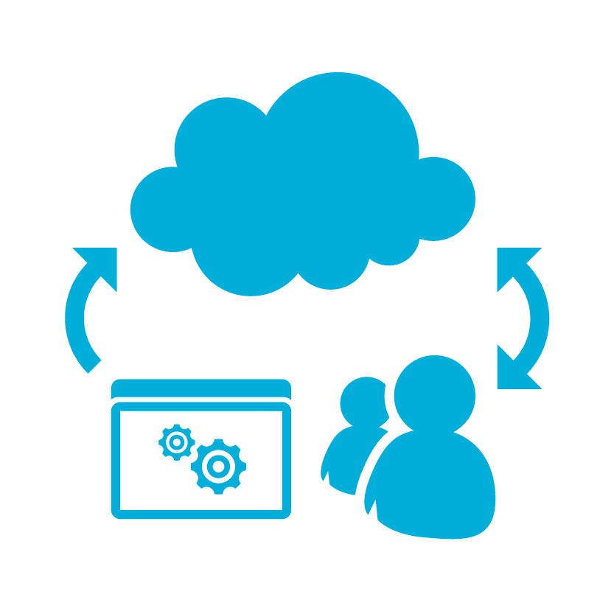
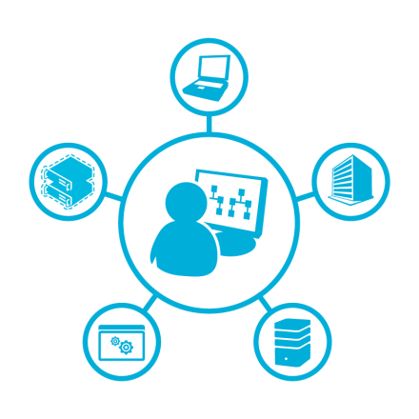
Azure Data Factory
Produce trusted information from raw data
Agility
Control
Highly scalable
Flexible schema
Non-relational data
Cloud and on-premises
Curation
Management
Monitoring
AGILITY
CONTROL

Slide 28

Connect to your data
SQL Server on-premises
SQL Server VMs, SQL Database, Azure blobs, tables
Gain agility on shapes and location
Leverage highly scalable data stores with flexible schemas (Hadoop)
Connect on-premises and cloud data
Leverage relational and non-relational data
Produce trusted information from raw data
SQL Server
SQL DB
SQL Server
Blob
VMs
Pipeline

Slide 29

Compose processing to curate data
SQL Server
SQL DB
SQL Server
Blob
VMs
Processing on data
Hadoop (Map/Reduce, Hive, Pig)
C#
Stored procedures
Copy
Data curation
Join, aggregate, cleanse, enrich
Pipeline
Copy (EL)
Hadoop
Code
C#
Code
Stored procedures

Slide 30





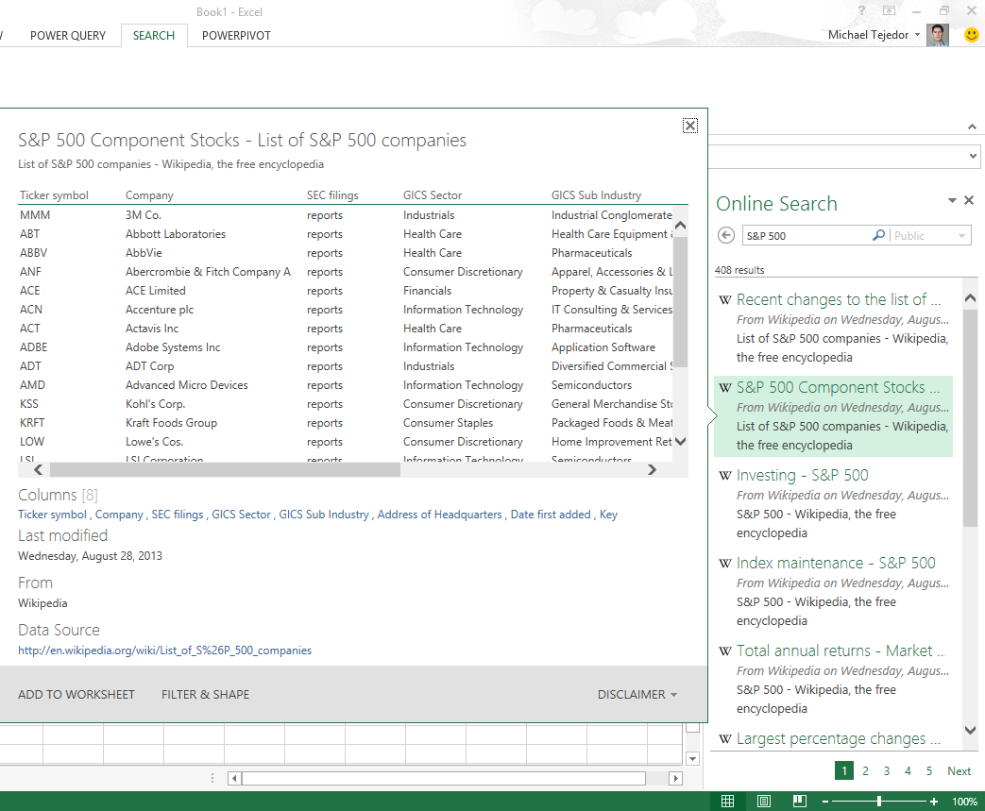
Output trusted insights
Consume data assets by BI tool or application
REST APIs for easy application integration

Slide 31
Azure Data Factory
Produce trusted information from raw data
Agility
Control
Highly Scalable
Flexible Schema
Non-relational data
Cloud and On-premise
Curation
Management
Monitoring
AGILITY
CONTROL

Slide 32
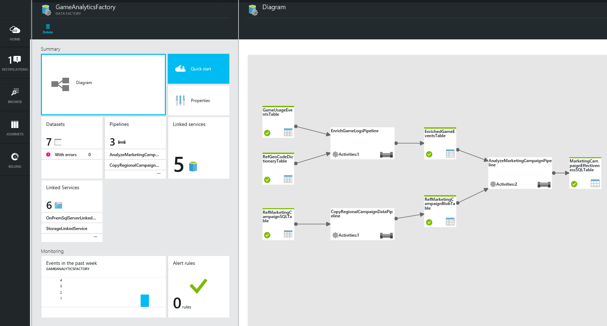
Manage and monitor
Manage from single pane of glass
No custom monitoring code required
Set data production policy
Retry, concurrency, late data handling
Identify and debug errors
Automatic data set health alerts
Troubleshooting of complex pipelines
Fully scriptable

Slide 33
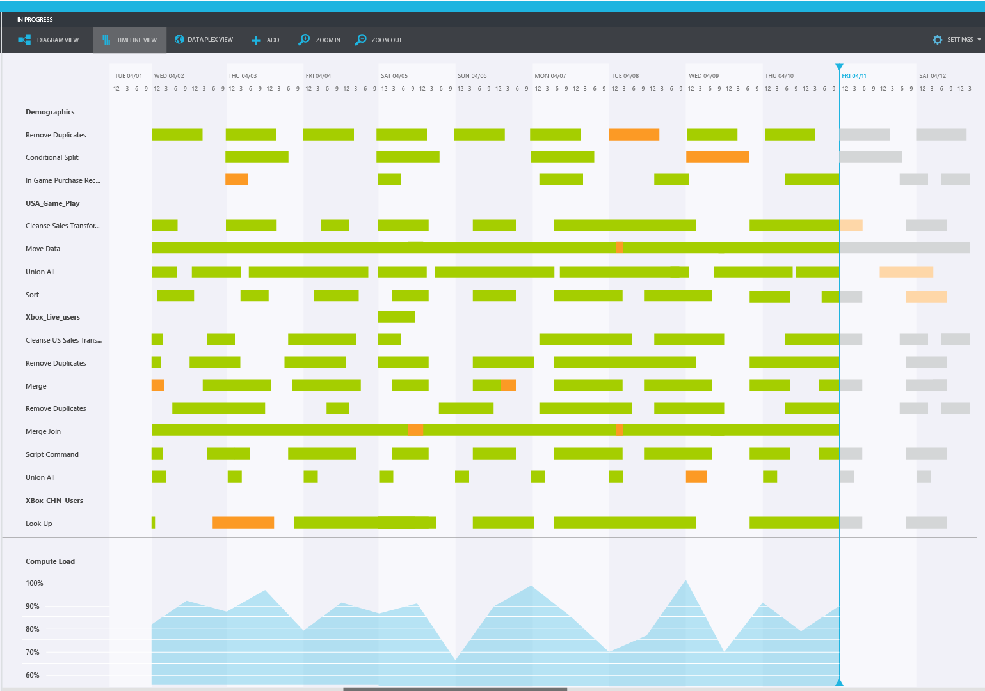
Rich scheduling
Rich scheduling controls
Frequency: Minutes, hours, days, etc.
Execute if precondition passes
Easily chain pipelines running on differing schedules
Easily restate previously produced data sets
Rerun a single activity invocation
Scheduled restatement with concurrency control (recalculate all data sets at once, etc.)

Slide 34
Lineage
Ability to trace data origins
Understand who is consuming my data
Determine how a field in my report was derived
Impact analysis
Understand impact of changing data or processing

Slide 35
Demo

Slide 36

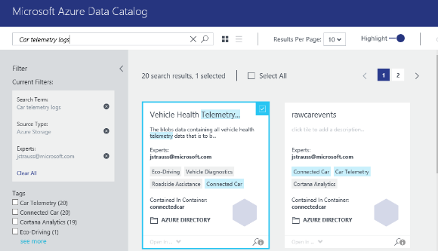
Get more value from your enterprise data assets
Information Management
Data Factory
Data Catalog
Event Hubs
Spend less time looking for data, and more time getting value from it
Register enterprise data sources, discover data assets and unlock their potential, and capture tribal knowledge to make data understandable
Bridge the gap between IT and the business, allowing everyone to contribute their insights, tags, and descriptions
Intuitive search and filtering to understand the data sources and their purpose
Let your data live where you want; connect using tools you choose
Integrate into existing tools and processes with open REST APIs

Slide 37

Ingest events from websites, apps and devices at cloud scale
Information Management
Data sources
SQL Database
Machine Learning
Data Factory
Apps
Azure
API
Management
Data Catalog
Storage
HDInsight
Sensors and devices
Event Hubs
Event Hubs
Backend Services
Stream Analytics
Power BI
Data
Log millions of events per second in near real time
Connect devices using flexible authorization and throttling
Use time-based event buffering
Get a managed service with elastic scale
Get a managed service with elastic scale
Reach a broad set of platforms using native client libraries
Pluggable adapters for other cloud services

Slide 38
Q&A

Slide 39

© 2016 Microsoft Corporation. All rights reserved.

